Slide 1
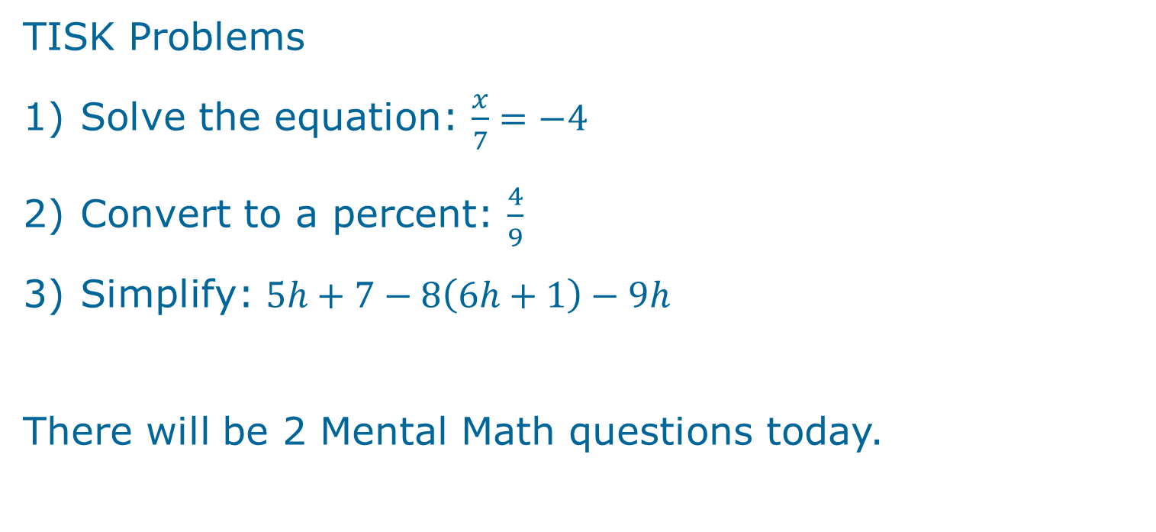
Wednesday, November 7, 2012
Agenda:
TISK & MM
Lesson 10-1: Solve 2-step equations.
Homework: p. 500 #16-32 even
TISK Problems
Solve the equation: $\frac{x}{7}=−4$
Convert to a percent: $\frac{4}{9}$
Simplify: $5h+7−8\left(6h+1\right)−9h$
There will be 2 Mental Math questions today.
Notes:
Mental Math
1.) Start with 8 more than -15. Multiply by 2. Add -21. Divide by -5. (7)
2.) Start with 7 more than -22. Multiply by 2. Add -15. Divide by -3. (15)

Slide 2
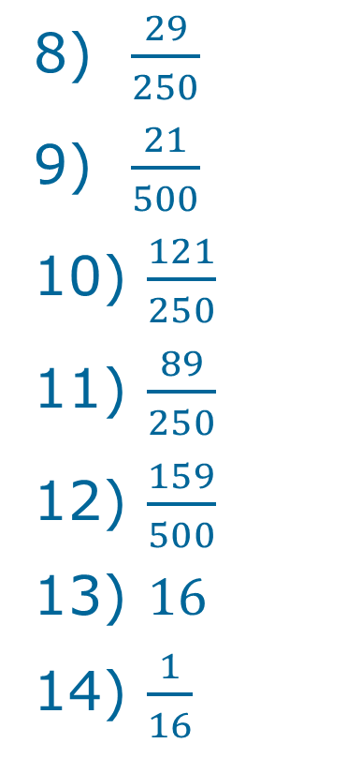
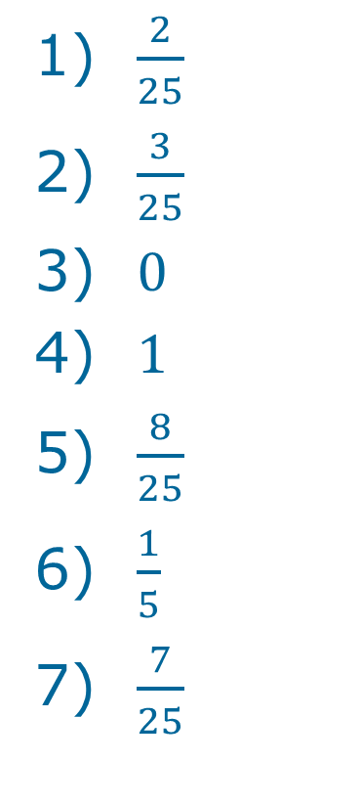
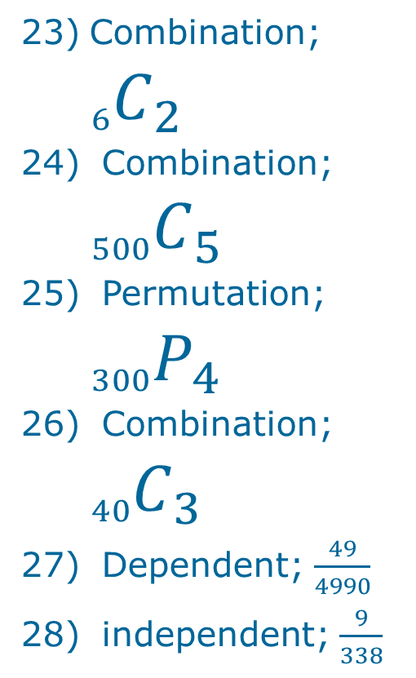
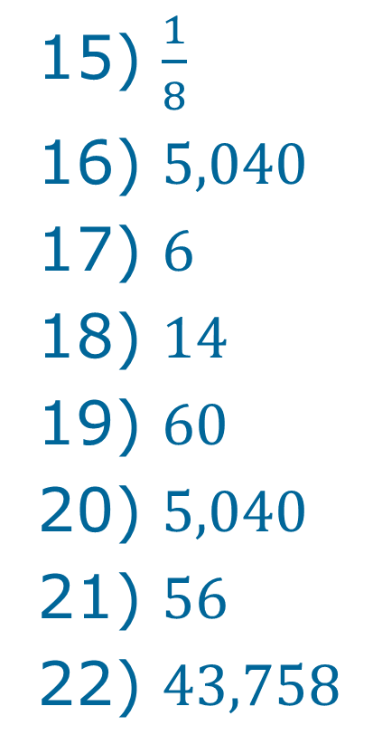
Ch. 9 Practice Test Answers
$\frac{29}{250}$
$\frac{21}{500}$
$\frac{121}{250}$
$\frac{89}{250}$
$\frac{159}{500}$
$16$
$\frac{1}{16}$
$\frac{1}{8}$
$5,040$
$6$
$14$
$60$
$5,040$
$56$
$43,758$
Combination; ${}_{6}^{}{C_{2}}$
Combination; ${}_{500}^{}{C_{5}}$
Permutation; ${}_{300}^{}{P_{4}}$
Combination; ${}_{40}^{}{C_{3}}$
Dependent; $\frac{49}{4990}$
independent; $\frac{9}{338}$
$\frac{2}{25}$
$\frac{3}{25}$
$0$
$1$
$\frac{8}{25}$
$\frac{1}{5}$
$\frac{7}{25}$

Slide 3

Ch. 9 Practice Test Answers
dependent; $\frac{200}{801}$
4:5
2:3
11:2
$\frac{3}{4}$
8:7

Slide 4
§10-1 Solving 2-step equations.
Remember the order of operations!
  When you solve an equation, you undo things in the opposite order that it was done.
  FIRST, add or subtract.
  THEN, multiply or divide.

Slide 5
Example 1. Solve the equation.

Slide 6
Check Point. You try it.

Slide 7
Example 2. Solve the equation.

Slide 8
Check Point. You try it.

Slide 9
Translating Expressions into Equations
Lily has four more candy bars than Brendan. Brendan has twice the number of candy bars as Audrey has. If they have a total of fourteen candy bars, how many does each person have?
To solve a question like this, it’s necessary to know what certain key phrases mean.

Slide 10
+
-
×
÷
=

Slide 11



Example 1. Translate into an equation and solve.
Lily has four more candy bars than Brendan. Brendan has twice the number of candy bars as Audrey has. If they have a total of fourteen candy bars, how many does each person have?
Then,
Let L = # of candy bars Lily has.
Let b = # of candy bars Brendan has.
Let a = # of candy bars Audrey has.
$$L=4+b$$
$$=4+2a$$
$$b=2a$$
$$\left(4+2a\right)+2a+a=14$$
And…

Slide 12






Now, to solve it…
$$\left(4+2a\right)+2a+a=14$$
$$4+2a+2a+a=14$$
Collect like terms.
$$4+5a=14$$
Add/Subtract.
$$−4$$
$$−4$$
$$\frac{}{5}$$
$$\frac{}{5}$$
$$5a=10$$
Multiply/Divide.
$$a=2$$
So, Audrey had 2 candy bars.
Lily had 4 + 2(2) = 4 + 4 = 8 candy bars.
$$L=4+2a$$
Brendan had 2(2) = 4 candy bars.
$$b=2a$$

Slide 13










Example 2. Write an equation then solve it.
Drew played video games for six fewer hours than Alex. If the two of them played for a total of 26 hours, how many hours did each boy play video games?
Let d = # of hours Drew played.
Let a = # of hours Alex played.
$$d=a−6$$
$$d+a=26$$
$$a−6+a=26$$
Collect like terms.
$$2a−6=26$$
Add/Subtract.
$$+6$$
$$+6$$
So, Alex played for 16 hours
$$\frac{}{2}$$
$$\frac{}{2}$$
$$2a=32$$
and Drew played for 16 – 6 = 10 hours.
Multiply/Divide.
$$a=16$$

Slide 14
Example 3. Write an equation then solve it.
Two-thirds of a number increased by seven is thirteen. What is the number?

Slide 15
Example 4. Write an equation & solve.
Four times the sum of a number and three times the number is 64. What is the number?

Slide 16
Example 5. Write an equation and solve.
Five less than triple a number is sixteen. What is the number?

